Slide 1

Organized Globally, Held Locally
@GPPBootcampBLR #GPPBootcampBLR #GlobalPowerPlatformBootcamp

Slide 2

Power Apps Portal
Nagesh Bhat
Sr Program Manager
@nageshbhat
@GPPBootcampBLR #GPPBootcampBLR
#GlobalPowerPlatformBootcamp

Slide 3



Sponsors

Slide 4



Microsoft Power Platform
One low-code platform that spans Office 365, Dynamics 365, Azure and standalone applications
Power BI
Business analytics
Power Apps
Application development
Power Automate
Workflow automation
Power Virtual Agents
Intelligent virtual agents
Common Data Service
Data connectors
AI Builder

Slide 5

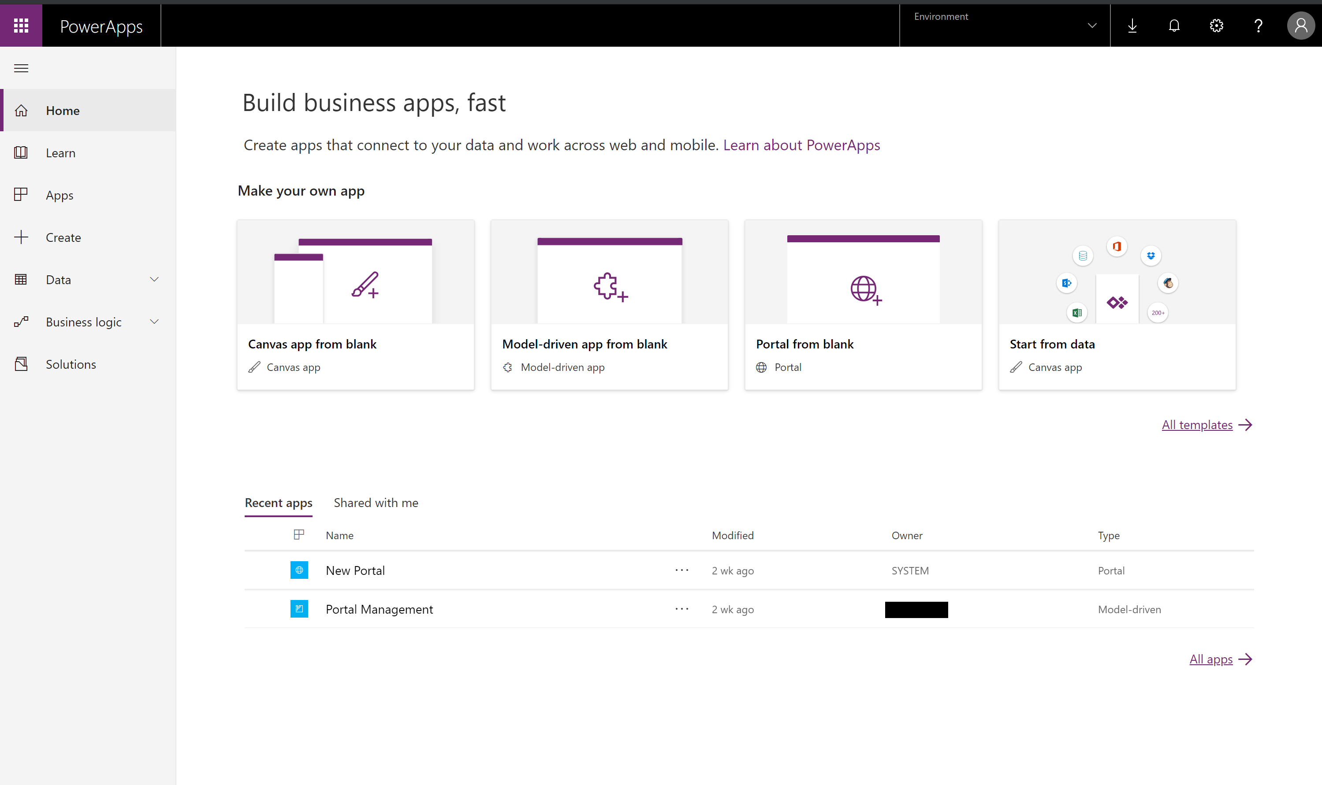
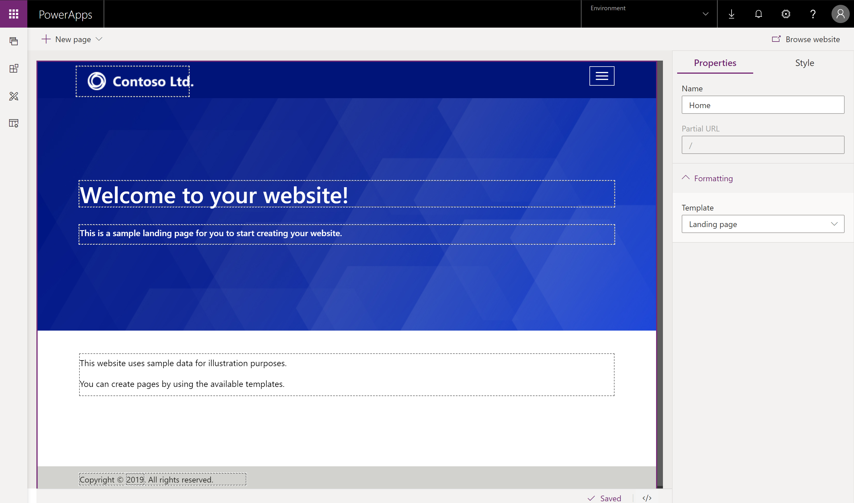

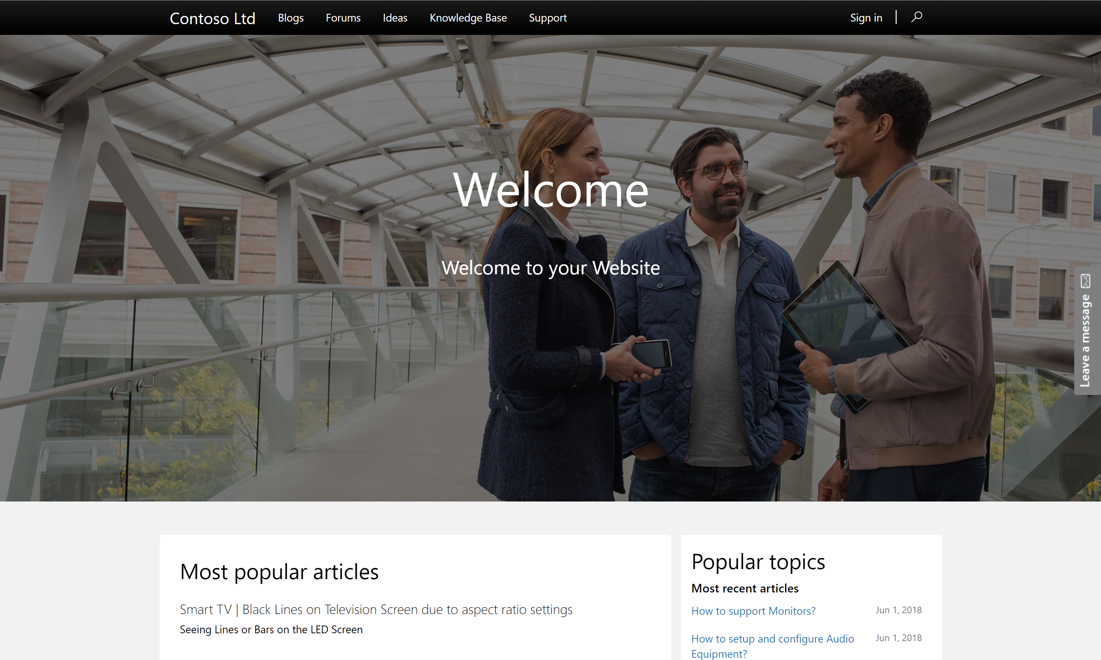
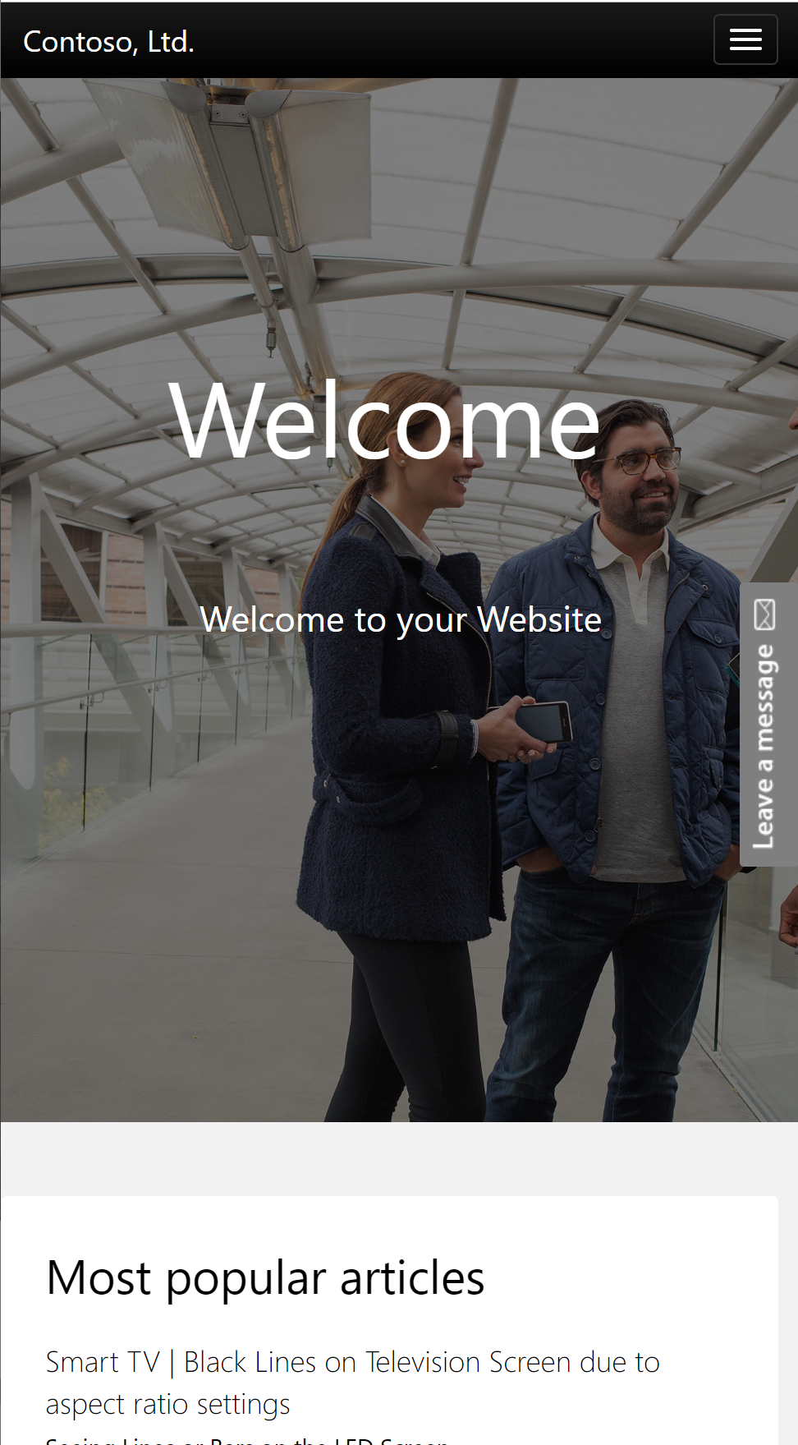

Power Apps Portals:: Engage with your customers
Low code solution for creating multilingual, responsive websites for users external to your organizations as well as internal employees.
Use any of the commercial or enterprise login providers like Microsoft Account, LinkedIn, Azure AD B2C etc or even allow anonymous access.
Use WYSIWYG designer to create website content and enrich with CDS/Dynamics data using familiar constructs like forms, views, charts, dashboards.
Pro dev extensibility and templating capabilities to design complex business processes.
Use prebuilt templates like Customer Self Service, Partner Management, Event Management, Community Self Service or create your own portal.

Slide 6

What can you do with Portals

Slide 7
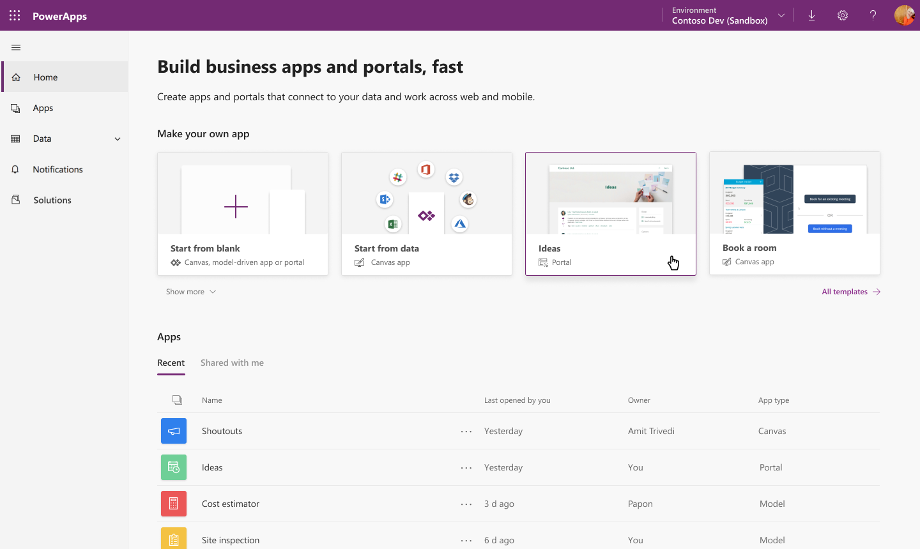
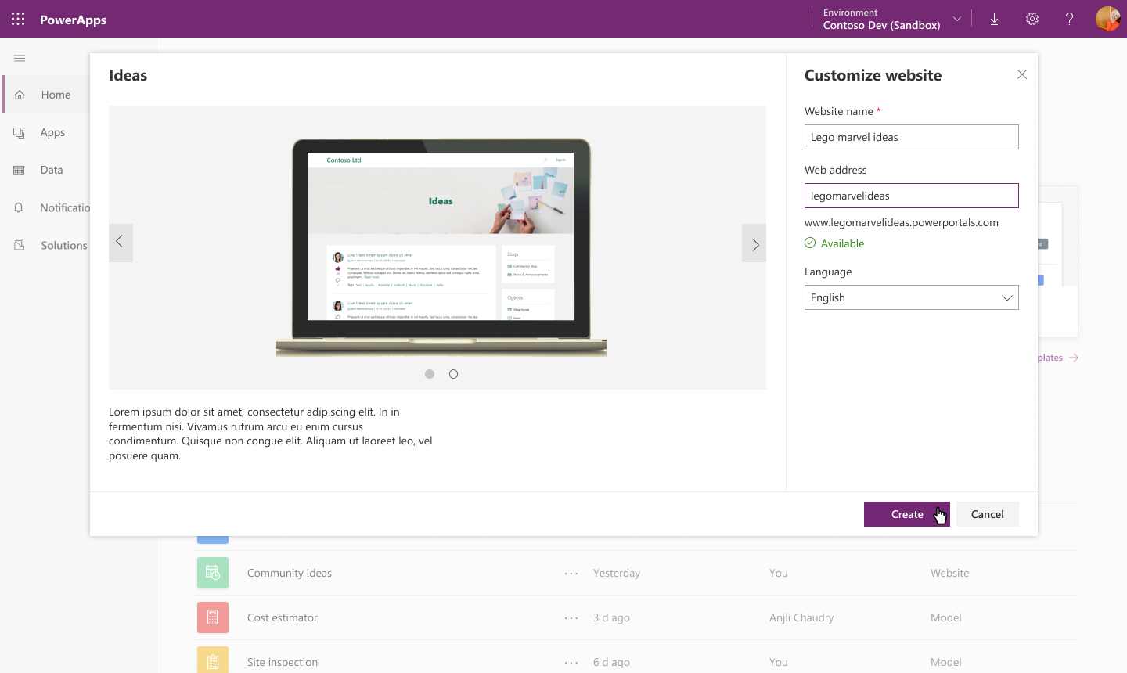
Quick and easy setup experience
Configure a new App type called “portal” from PowerApps home
Create a portal for CDS or Dynamics database
Use a prebuilt Dynamics application template like customer self service, partner management, event management etc or create your own portal.

Slide 8
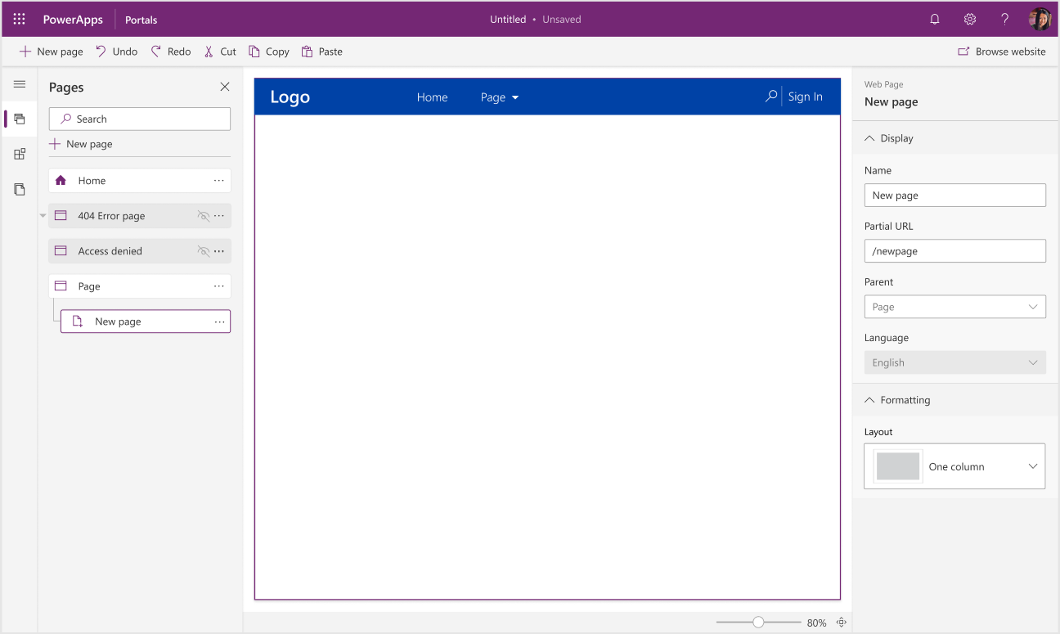
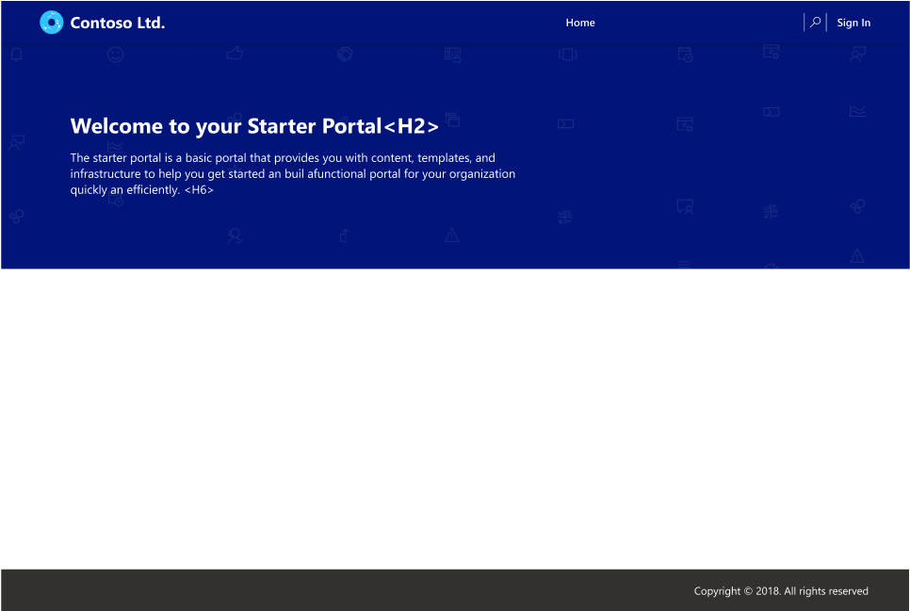
Easy to use Portal Designer Experience
Simplified Portal Designer to customize content of your website.
Create and manage pages in few clicks increasing your productivity multifold
Select predefined layouts or create your own templates (web templates)

Slide 9
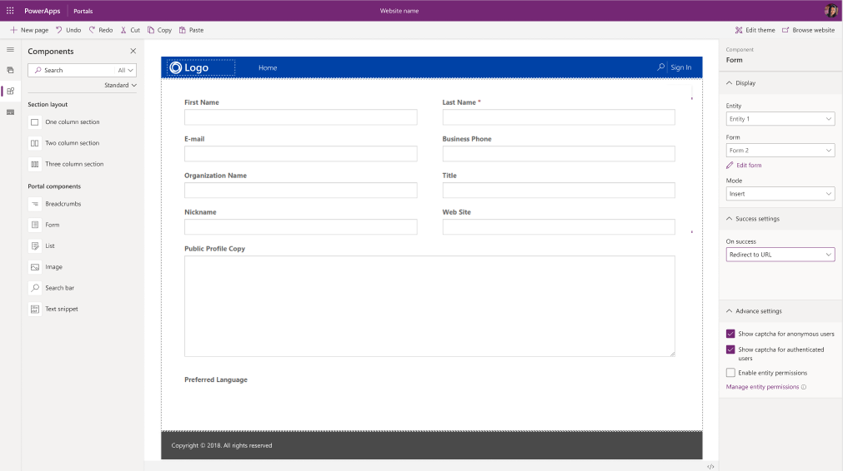
Expose your CDS/Dynamics data in few clicks!
Reuse Model driven app constructs like forms, views, charts, dashboards etc to surface CDS data
One click integration with Form and View designers to help you update/create new forms/views.
Advanced form/view capabilities like CAPTCHA, geolocation, custom actions, workflow actions etc

Slide 10
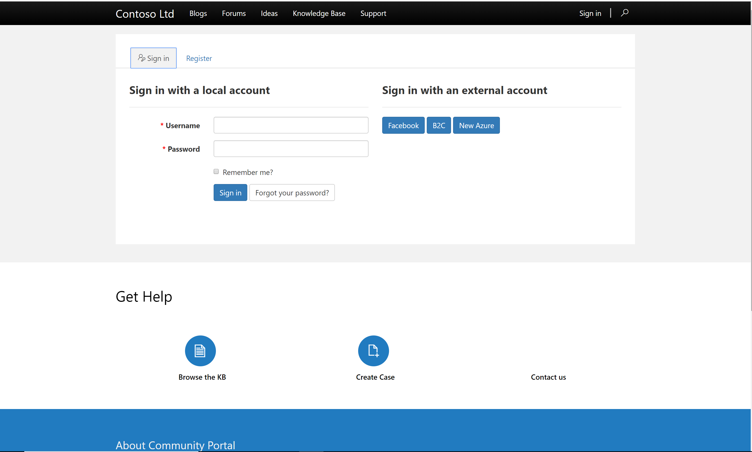
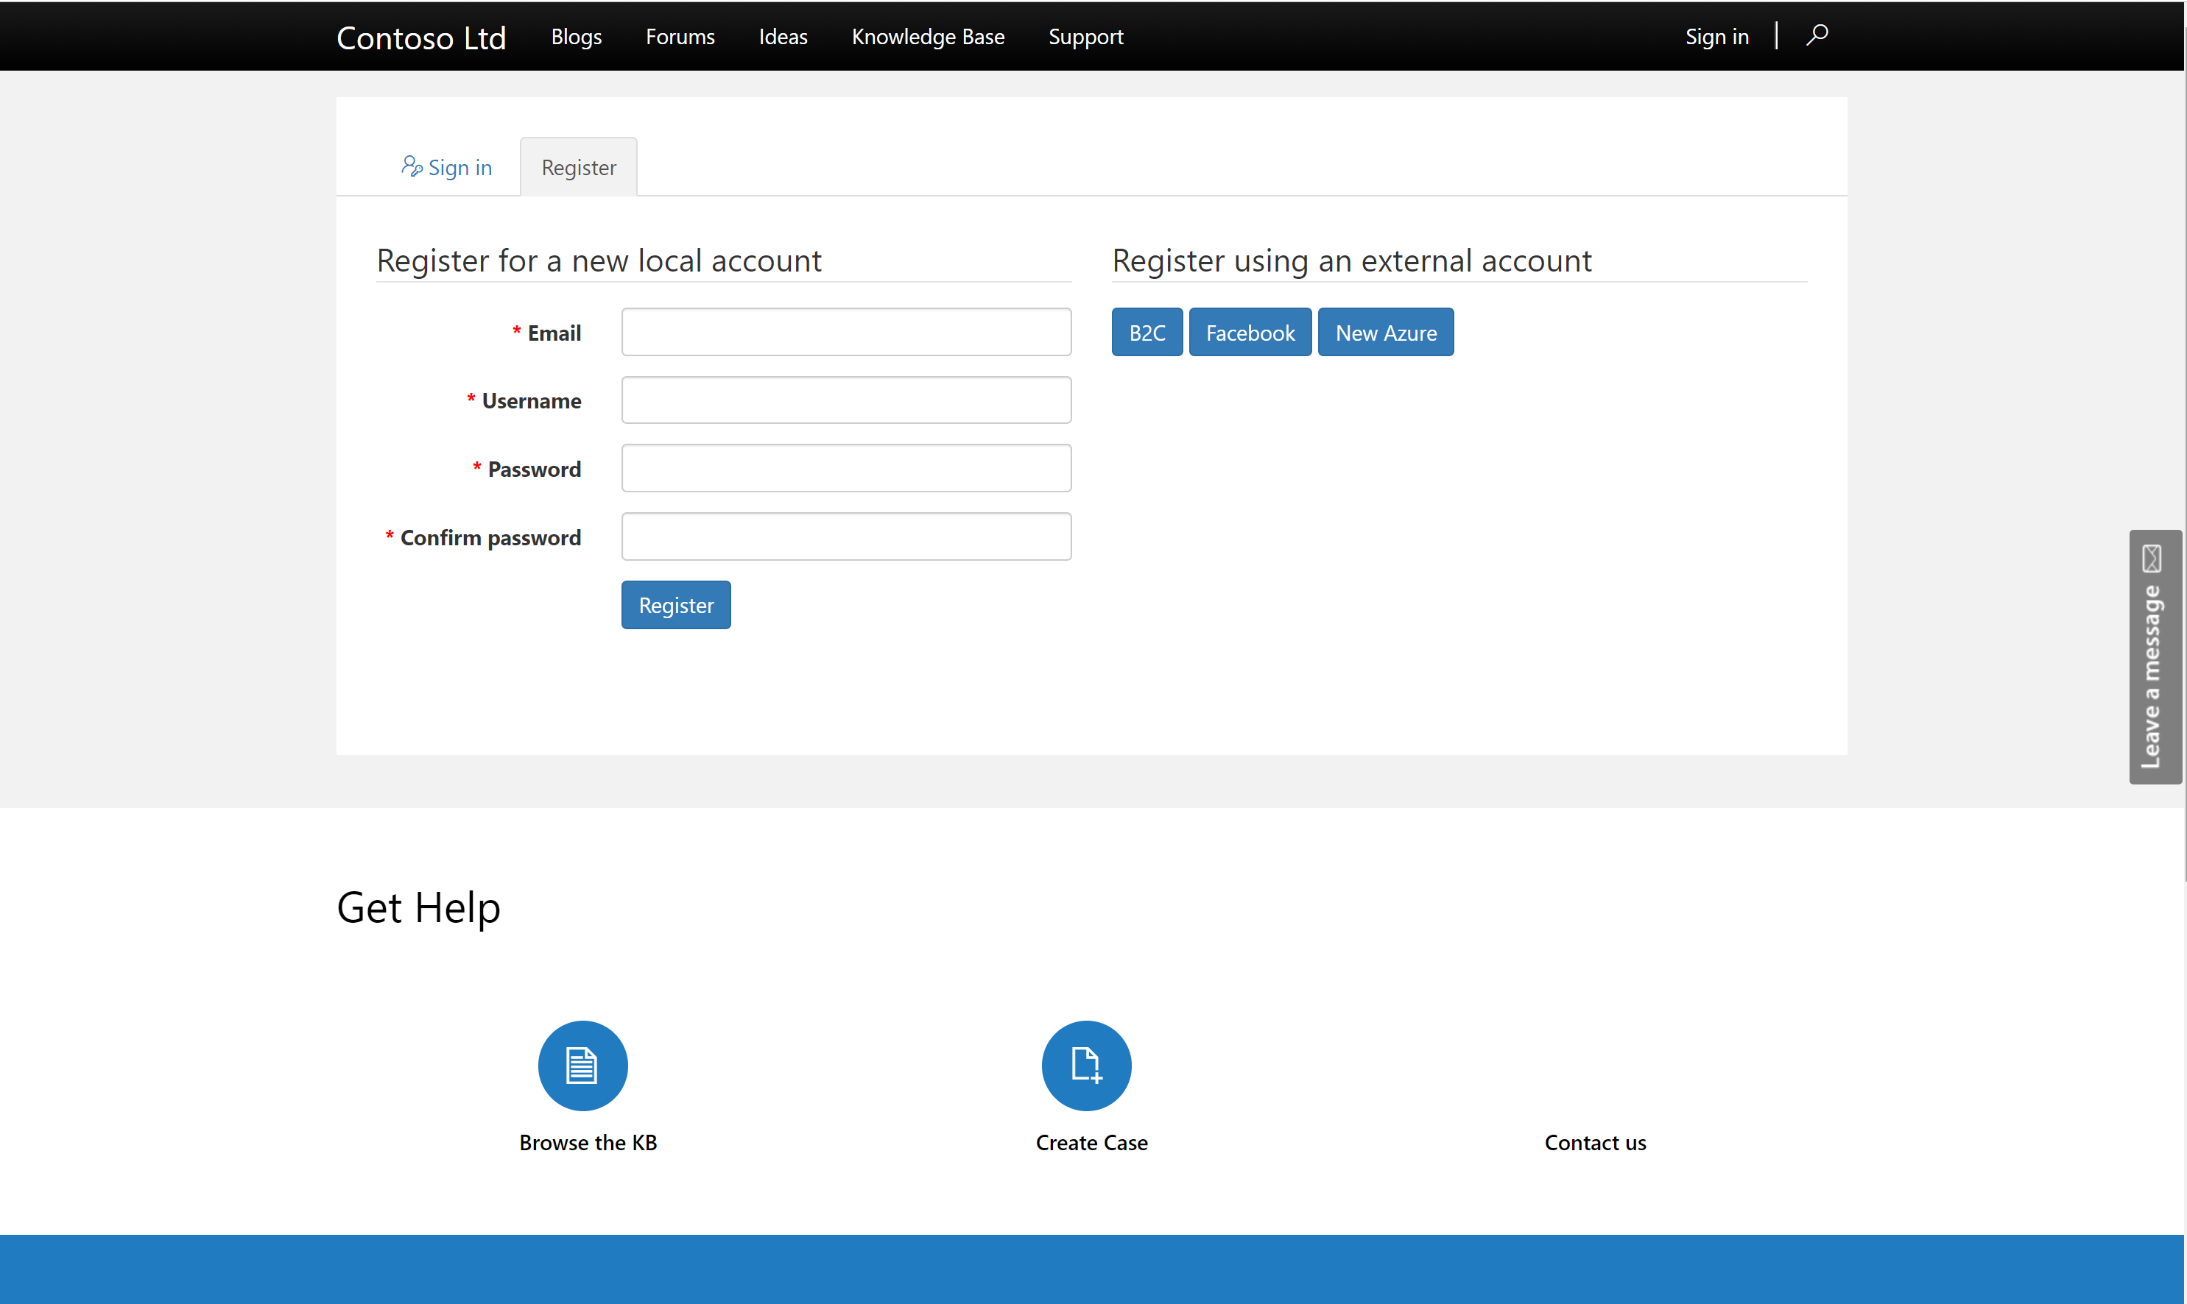
Extend to multiple audiences
Create Portals for users outside your organizations as well as internal employees.
Enable a variety of commercial login providers like Microsoft Account, LinkedIn, Facebook as well as enterprise Identity Providers like Azure AD B2C, Okta, Auth0 etc.
Enable Self Service Registration for end users or extend it to select users.
Enable Anonymous access for select content.

Slide 11
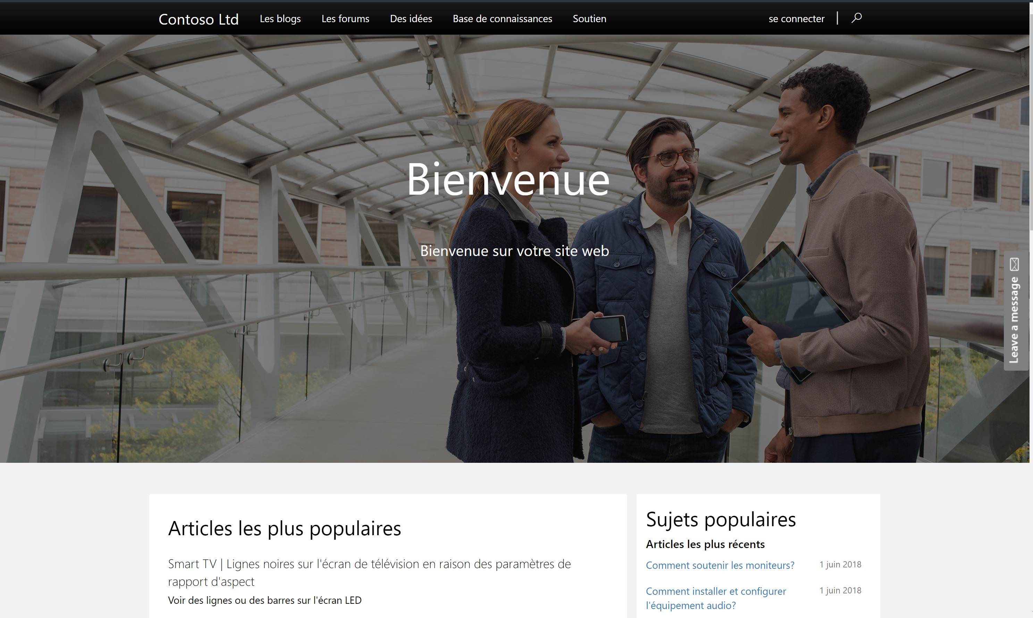
Create Pixel perfect, responsive and multilingual sites
Create pixel perfect websites using your own css or inline styles.
Use bootstrap themes to create responsive sites which work on every surface
Supports 43 base CDS languages (everything except RTL).
Supports language variations (like English(UK), French(Canadian) etc)
Fully accessible controls conforming to various standards.

Slide 12
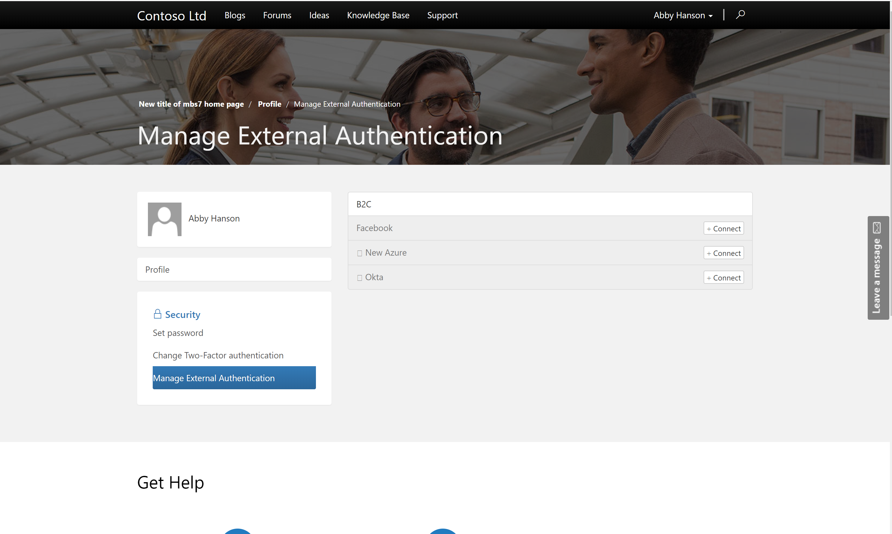
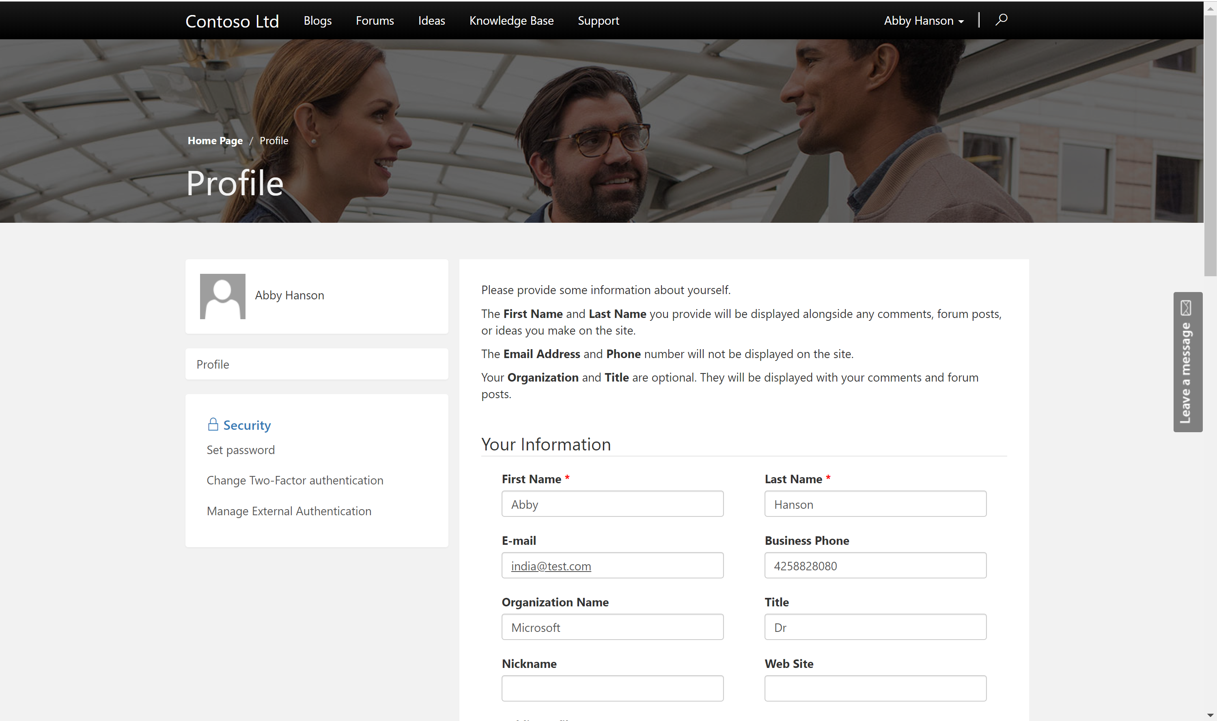
Profile Management and Security Model
All Portal users are modelled as contacts in CDS database.
Contact/Account based security model optimized for B2C as well as B2B interactions.
Self Service Profile Management right within the portal.
Allow users to link identities from multiple identity providers.

Slide 13
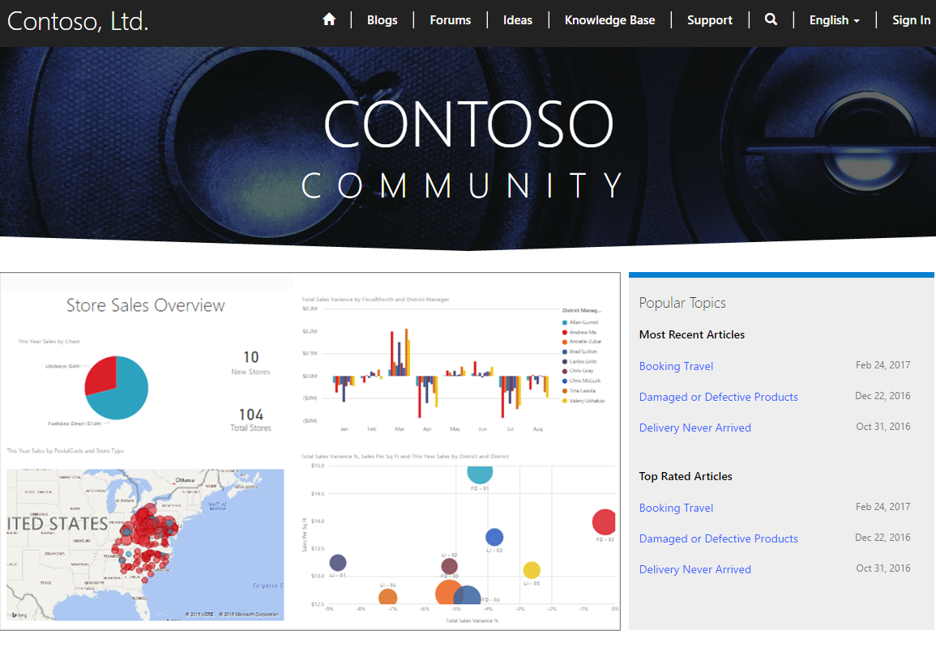
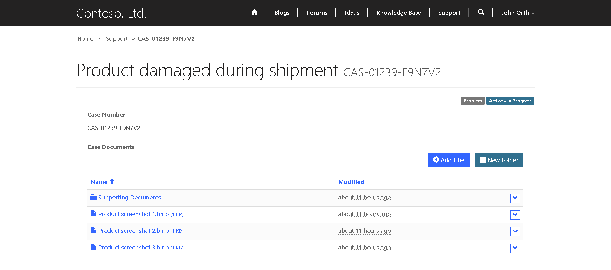
Integrate with other Microsoft Services
Integrate PowerBI embed components like reports, dashboards and tiles.
Integrate SharePoint, Azure Blob storage as document storage.
Integrate with Azure AD B2C as Identity provider
Integrate with Azure Application Insights for usage telemetry, Azure Application Gateway for providing additional security

Slide 14
Pro dev Extensibility and Governance
Ability to access CDS data and enable personalization using liquid templating language.
Ability to create reusable web templates for defining page layouts as well as web services.
Use CDS server side constructs like code plugins, workflows as well as Microsoft flow to extend business logic.
Advanced admin options like IP address filtering, server side logs, Portal Checker and many more

Slide 15
Demo

Slide 16
Any Questions?

Slide 17
Next Session:

